Slide 1
Automatic Name-based Software Bug Detection during Static Program Analysis
Team Members:
Shashank Ghimire (THA076BEI032)
Shirshak Acharya (THA076BEI033)
Yunij Karki (THA076BEI044)
Dipu Dahal (THA076BEI045)
Under the Supervision of
Er. Dinesh Baniya Kshatri
Department of Electronics and Computer Engineering
Institute of Engineering, Thapathali Campus
March 9, 2023

Slide 2
Presentation Outline
Motivation
Introduction
Objectives
Scope of Project
Project Applications
Methodology
Dataset Exploration
Results
Discussion of Results
Future Enhancements
Conclusion
References

Slide 3
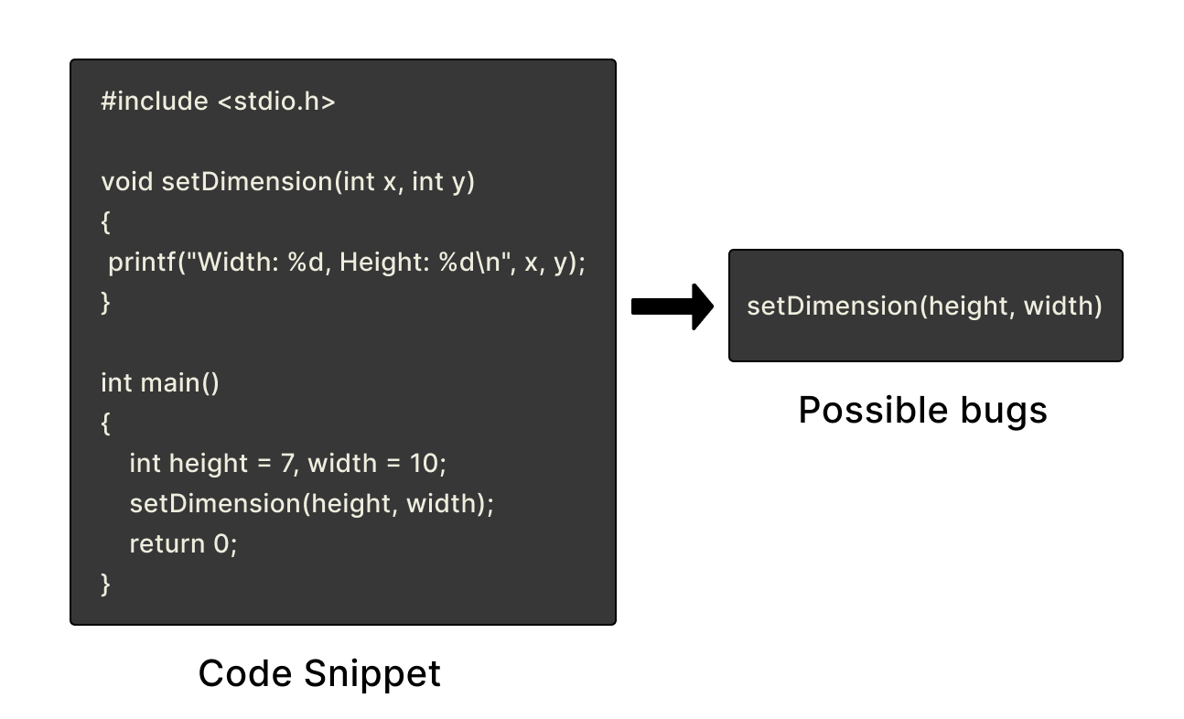

Motivation
Programmer frustrated by manual analysis of bugs
Tool to automatically detect some bugs in source code

Slide 4
Introduction
Name-based bugs refer to errors in the names of variables, function arguments, operators
Static analysis is the detection of bugs in source code before compilation
Learning-based approach has been adopted to scan source code to identify potential name-based bugs

Slide 5
Objectives
To create suitable training data consisting of correct and buggy code from a corpus of source code written in the C-programming language
To train and evaluate a transformer model capable of name-related bug detection during static code analysis

Slide 6
Scope of Project
Project Capabilities:
Automatically generates negative samples from correct code using AST
Localizes swapped function arguments & wrong binary operators
Project Limitations:
Detects only two types of name-based bugs
Handles code written in C programming language
Behaves incorrectly if identifiers are named improperly

Slide 7
Project Applications
Bug Identification
Reduces the need for manual code review
Improving Code Quality
Minimizes the number of errors and crashes
Coding Competitions
Locates bugs in source code & acts as an automated judge
Coding Interview
Identifies bugs in candidate's code quickly & accurately
Boosting Coding Efficiency
Increases productivity and saves time for developers

Slide 8
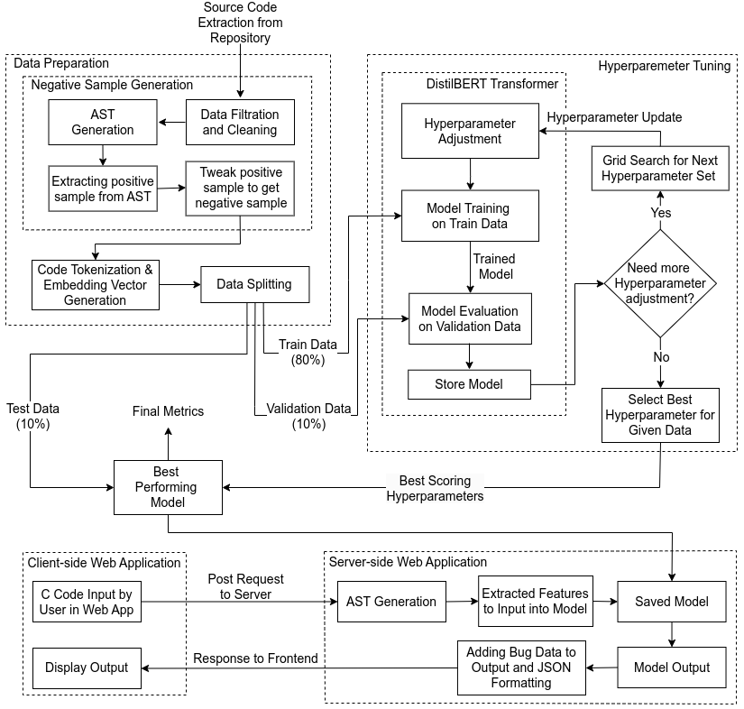
Methodology - [1]
(System Block Diagram)

Slide 9
Methodology - [2]
(Working Principle)
Source code is extracted from C Code Corpus dataset
Only the code snippets with less than 10k lines of code are taken and missing data are handled
AST is generated and positive samples are extracted
Dataset containing positive samples were split such that train (80%), validation (10%) & test (10%)
Negative samples generated with the help of positive samples

Slide 10
Methodology - [3]
(Working Principle)
CodeT5 tokenizer was fine-tuned on C code
Code tokenization and Embedding vector generation was done
Model was trained with DistilBERT & CodeT5 tokenizer
Hyperparameters were tuned using Grid Search
Transformer outputs result as 0 (correct) or 1 (incorrect)
Client-side and server-side web app were implemented

Slide 11
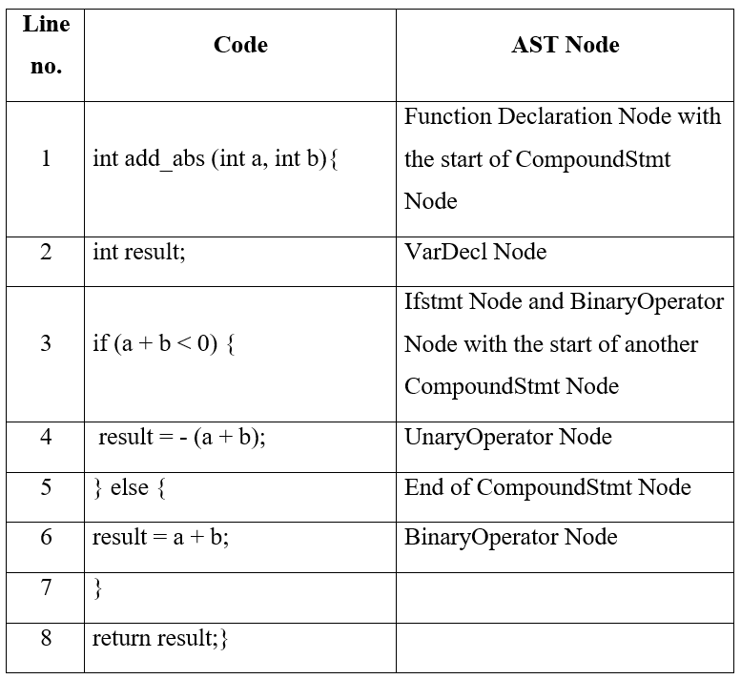
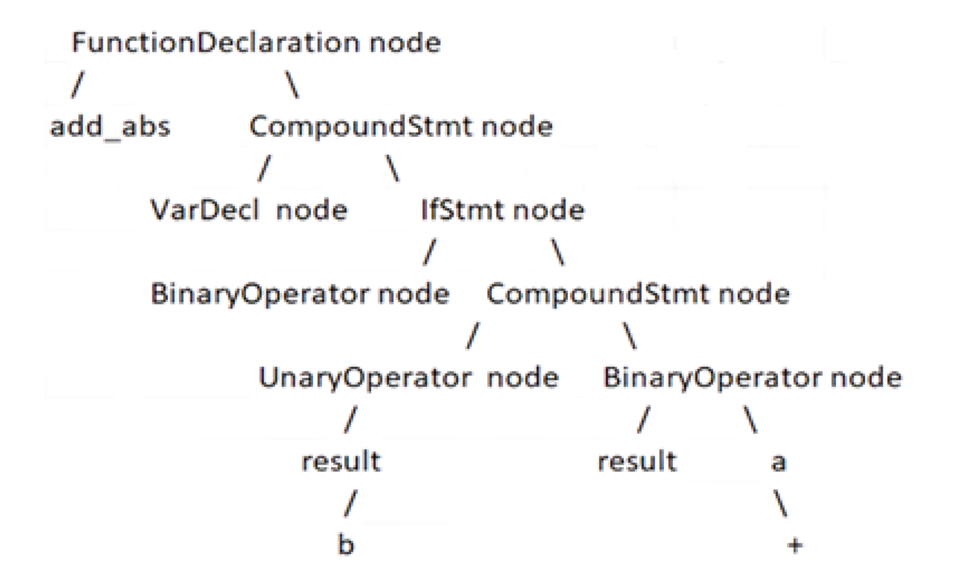

Methodology - [4]:
(AST - General Structure of Function Declaration)

Slide 12
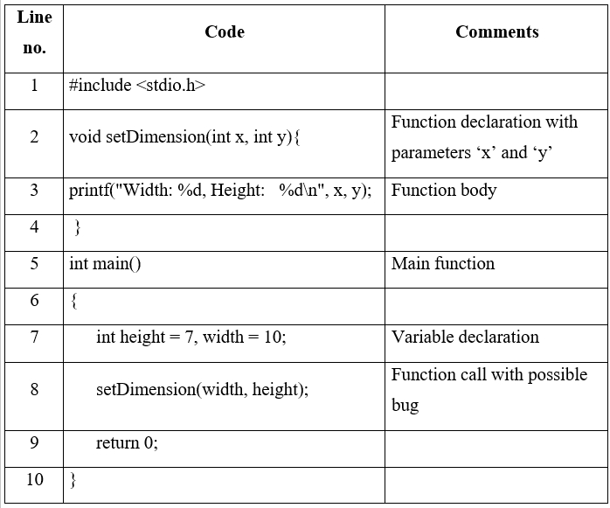
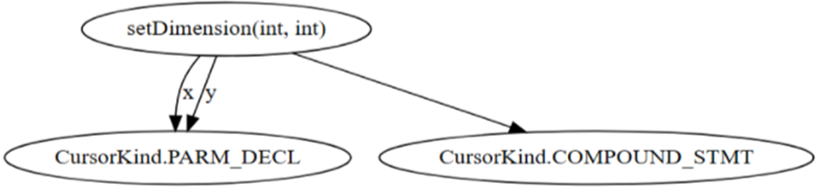
Methodology - [5]:
(AST Generation - Function Arguments Swap)

Slide 13
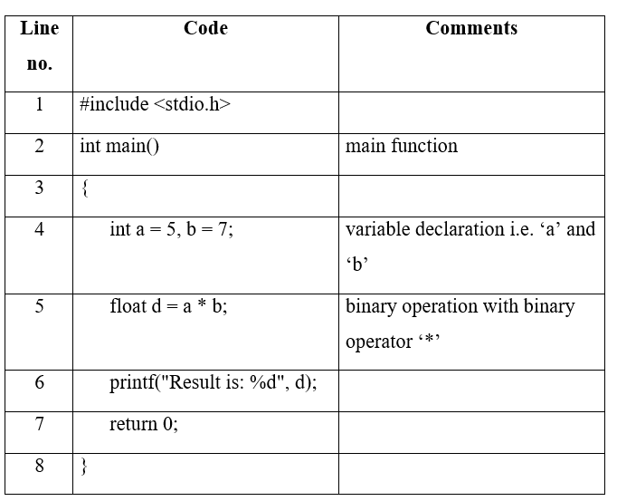
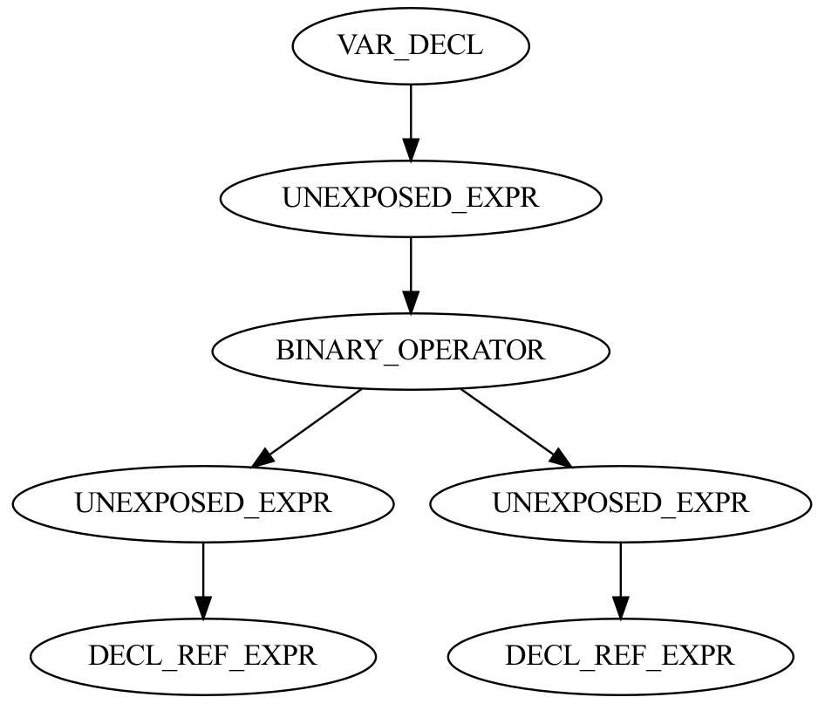
Methodology - [6]:
(AST Generation - Wrong Binary Operator)

Slide 14
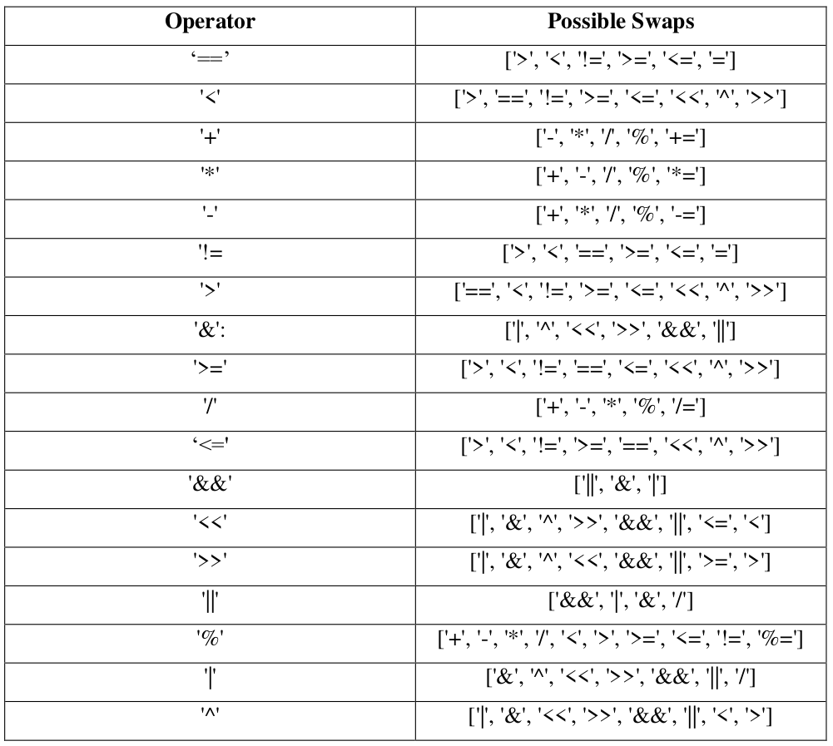
Methodology - [7]:
(Possible Operator Exchanges)

Slide 15
Methodology - [8]:
(Negative Sample Generation - Swapped Function Args)
Positive sample extracted from AST for Swapped function args bug
Label positive sample as 0
Swap the operator and label sample as 1 (negative)
function_name | arg1 | arg2 | arg_type | param1 | param2 | labels
setDimension | width | height | int | x | y | 0
setDimension | height | width | int | x | y | 1

Slide 16
Methodology - [9]:
(Negative Sample Generation - Wrong Binary Operator)
Positive sample extracted from AST for Wrong binary operator bug
Label positive sample as 0
Swap the operator and label sample as 1 (negative)
left | operator | right | type_left | type_right | parent | grandparent | labels
i | < | linkCount1 | int | int | FOR_STMT | COMPOUND_STMT | 0
i | <= | linkCount1 | int | int | FOR_STMT | COMPOUND_STMT | 1

Slide 17
Methodology - [10]:
(Input Embedding of Tokens)
Process of mapping tokens to the vectors of real numbers
Words with same meaning have a similar d-dimensional vector values
Used to convert input tokens into vectors
Can help to predict output for unseen data

Slide 18
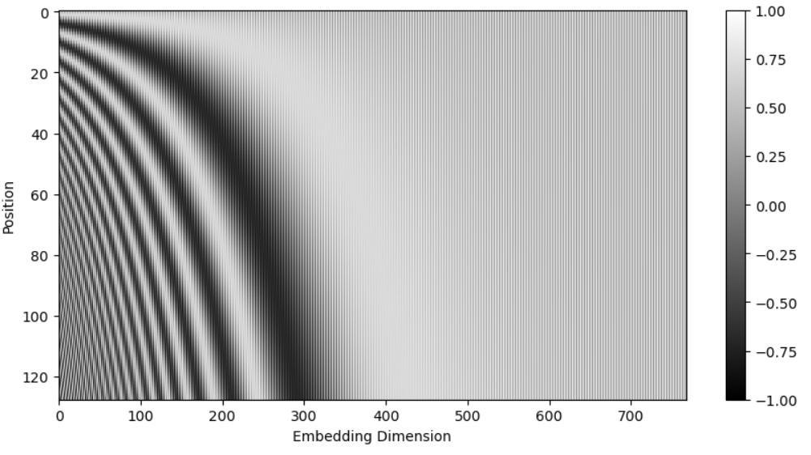
Methodology - [11]:
(Positional Encoding of Tokens)
Preserves information about position of tokens in sequence
PE_{(pos, 2i)} = sin(pos/10000^{2i/d})
PE_{(pos, 2i+1)} = cos(pos/10000^{2i/d})
Where ‘pos’ is token position, ‘d’ is length of positional encoding vector and ‘i’ ranges from 0 to d/2
Notes:
Required to preserve the syntactic and semantic meaning

Slide 19
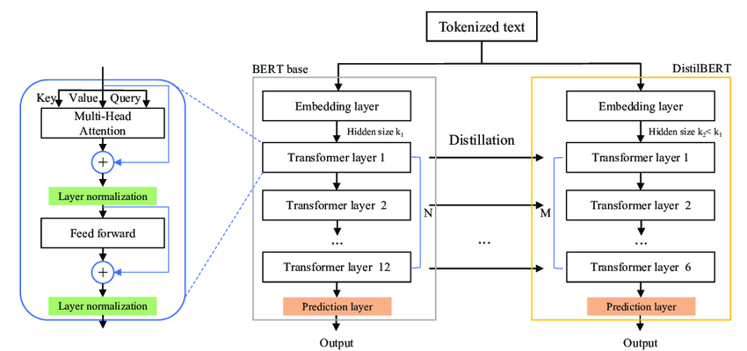
Methodology - [12]:
(DistilBERT transformer model)

Slide 20
Methodology - [13]:
(Model Evaluation)
Binary Cross Entropy Loss Function
Loss function for binary classification problem
BCE = −(y × log(y') + (1 − y) × log(1 − y') )
F1 Score
considers both precision and recall
F1 Score =
2 × precision × recall
precision + recall

Slide 21
Methodology - [14]:
(Hardware and Software Requirements)
Kaggle
Hosted Jupyter notebook service for model training
GPU
Processor to accelerate training through parallel processing
GPU with 15.9 GB RAM used
Available GPUs: Nvidia T4 x 2 and P100

Slide 22
Methodology - [15]:
(Hardware and Software Requirements)
Pytorch
Python ML framework used for model training
Fast API
Python based web framework
Used at server-side for creating API
React
Javascript based frontend web framework

Slide 23
Dataset Exploration - [1]
C code corpus dataset
Raw corpus data of C source files
720,000 code files of C programming
2.5 GB in compressed form and 12 GB when uncompressed
486,534 total samples in swapped function arguments dataset
1,111,986 total samples in wrong binary operator dataset

Slide 24
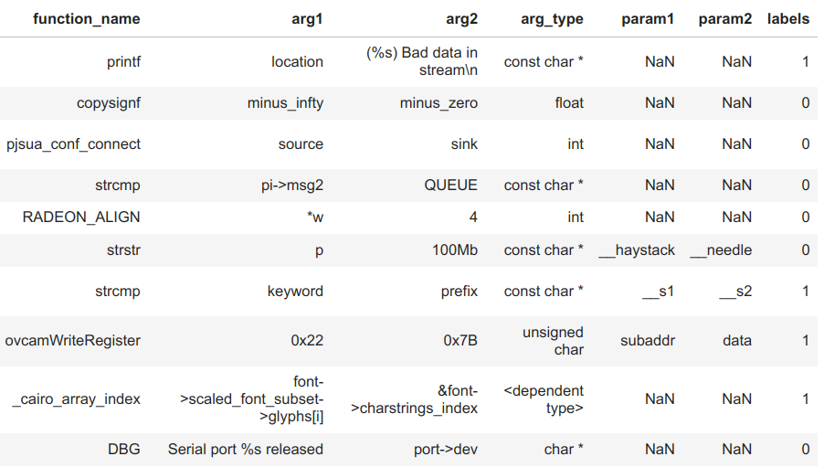
Dataset Exploration - [2]
(Swapped Function Arguments - Train Dataset Preview)

Slide 25
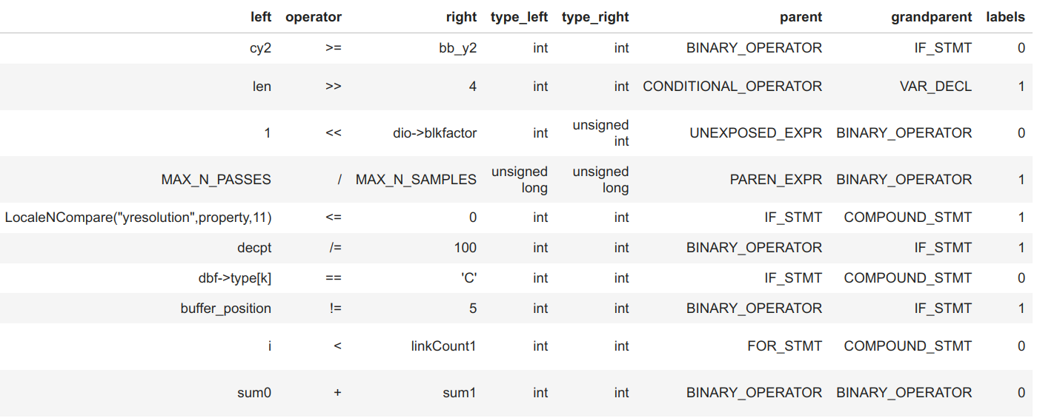
Dataset Exploration - [3]
(Wrong Binary Operators - Train Dataset Preview)

Slide 26
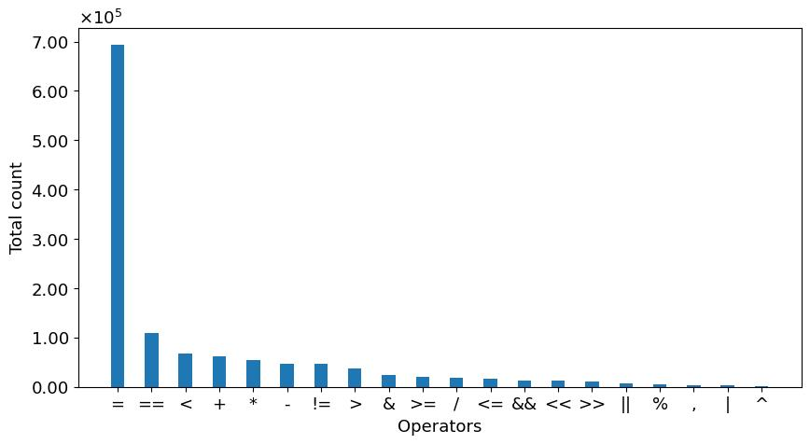
Dataset Exploration - [4]
(Bar Plot of Operator Count)

Slide 27
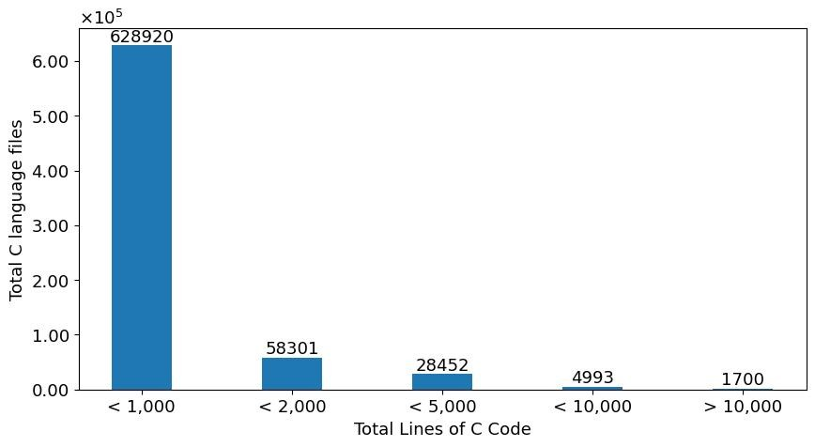
Dataset Exploration - [5]
(Count of Total Lines of Code)

Slide 28
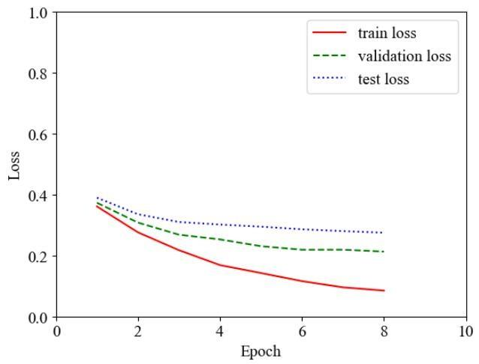
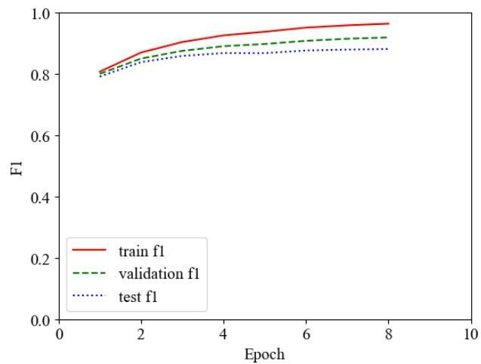
Results - [1]
(Swapped Function Arguments - Loss & F1 Score)

Slide 29
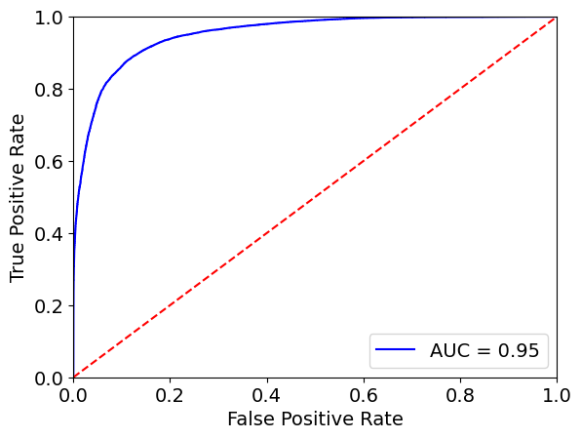
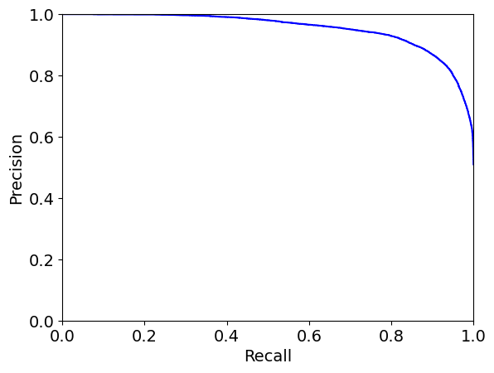
Results - [2]
(Swapped Function Arguments - ROC & PR Curve)

Slide 30
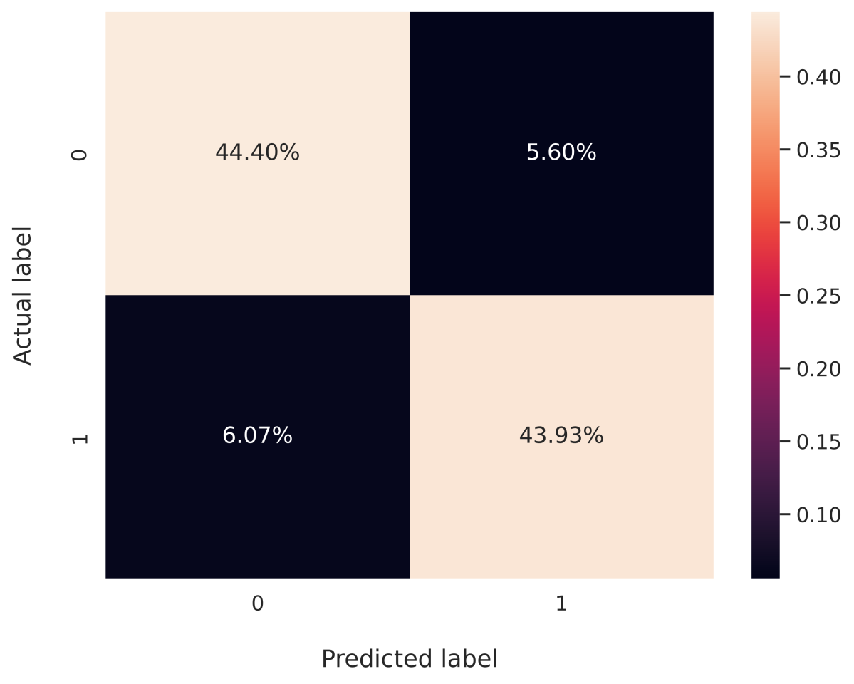
Results - [3]
(Swapped Function Arguments - Confusion Matrix)
True Positive = 43.93%
True Negative = 44.40%
False Positive = 5.60%
False Negative = 6.07%
Generally, in ML, 1 is taken as positive class so buggy prediction is positive here

Slide 31
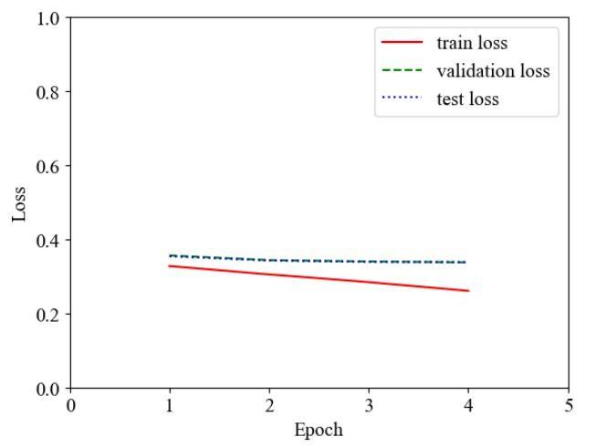
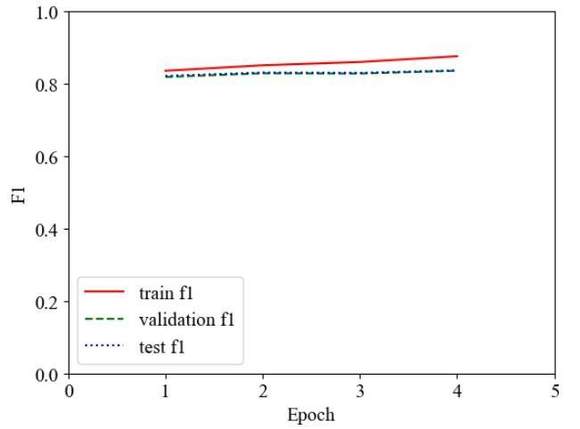
Results - [4]
(Wrong Binary Operator - Loss & F1 Score)

Slide 32
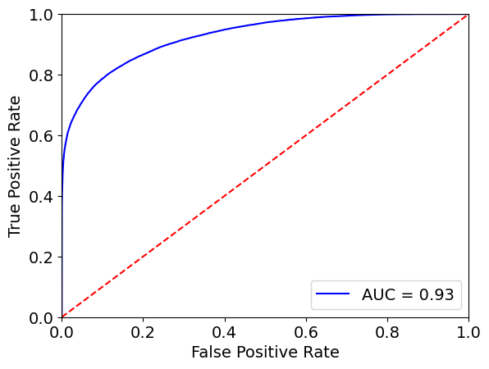
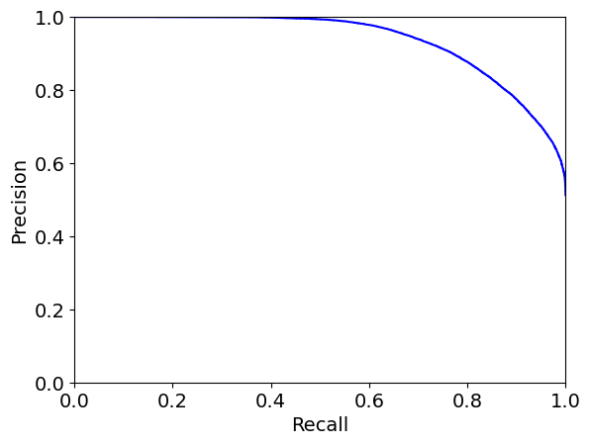
Results - [5]
(Wrong Binary Operator - ROC & PR Curve)

Slide 33
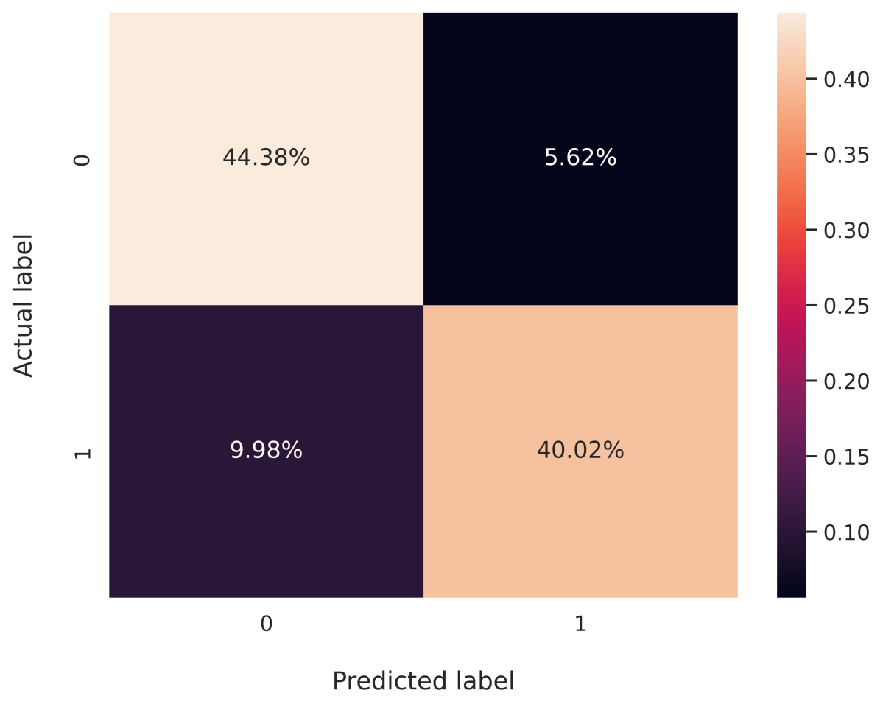
Results - [7]
(Wrong Binary Operator - Confusion Matrix)
True Positive = 40.02%
True Negative = 44.38%
False Positive = 5.62%
False Negative = 9.98%
Generally, in ML, 1 is taken as positive class so buggy prediction is positive here

Slide 34
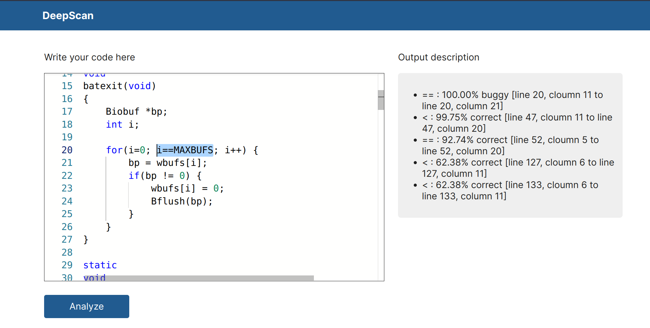
Results - [6]
(User Interface - Wrong Binary Operator Example)

Slide 35
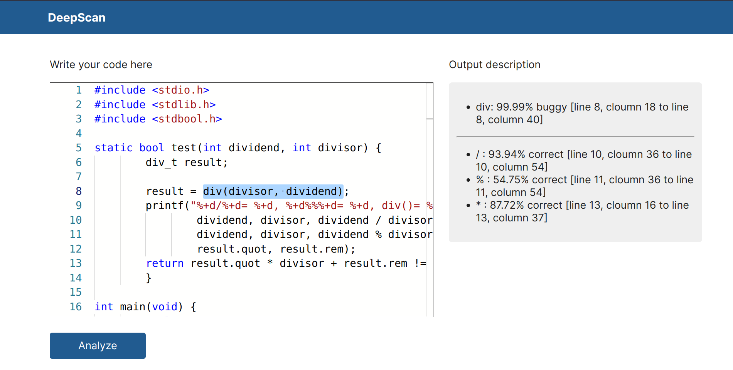
Results - [8]
(User Interface - Swapped Function Arguments Example)

Slide 36
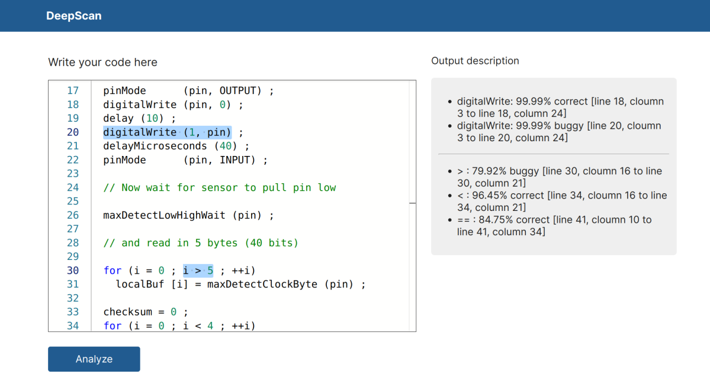
Results - [9]
(User Interface - Multiple Types of Bugs Example)

Slide 37
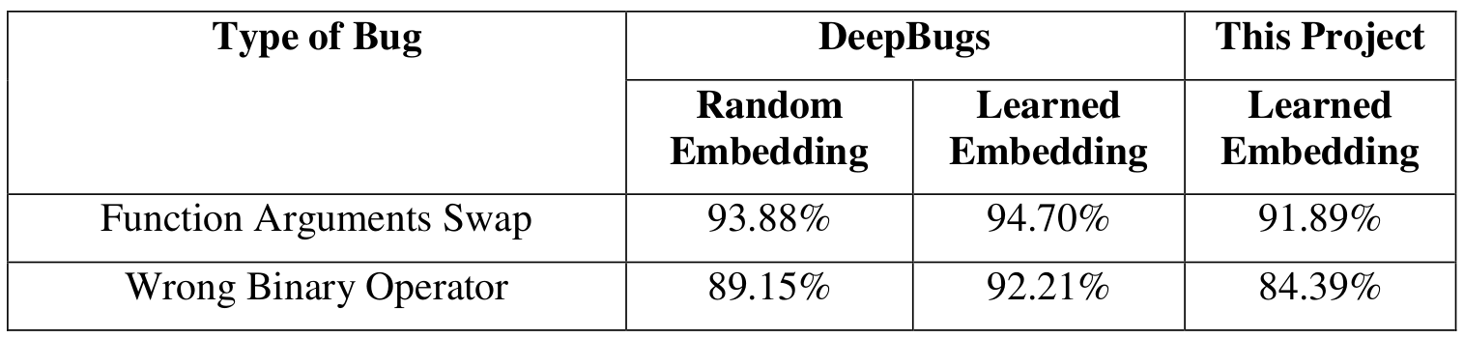
Results - [10]
(Comparison of Performance with Similar Projects)
Comparable but slightly less accuracy can be due to:
Hyperparameter tuning with low number of hyperparameters
Use of different language (i.e. Javascript in DeepBugs)

Slide 38
Discussion of Results
Swapped function arguments model
Validation dataset: Accuracy = 91.89%, F1 score = 91.89%
Test dataset: Accuracy = 88.10%, F1 score = 88.12%
Training time: 45 minutes for 1 epoch (total 8 epochs)
Wrong binary operator model
Validation dataset: Accuracy = 84.39%, F1 score = 83.60%
Test dataset: Accuracy = 84.40%, F1 score = 83.69%
Training time: 1 hour and 40 minutes for 1 epoch (total 4 epochs)
The percentage of correctness or bugginess in the output is due to the softmax function

Slide 39
Future Enhancements
Exploring other transformer-based models
BERT, RoBERTa, ALBERT
Introduction of other types of name based bugs
Wrong operator precedence, wrong binary operands
Detection of bugs in multiple programming languages
Include name-based bug detection in languages other than C
Same concepts and steps used in this project can be applied

Slide 40
Conclusion
Suitable dataset consisting of correct and buggy samples of C language was created
CodeT5 tokenizer and DistilBERT model were used
Implemented two types of name-based bug detection models: swapped function arguments & wrong binary operator
Notes:
Due to the time constraints and complexity of project, we could only design our model to a limited level. However there is always room for improvement.

Slide 41
References - [1]
Allamanis, Miltiadis et al., “Self-Supervised Bug Detection and Repair.”, 2021. Arxiv, https://arxiv.org/abs/2105.12787. Accessed 3 Jan, 2023
Saikat Chakraborty et al., “Deep Learning-based Vulnerability Detection: Are We There Yet?”, 2021. Arxiv, https://arxiv.org/abs/2009.07235. Accessed 5 Jan, 2023
Pewny, Jannik, and Thorsten Holz. “EvilCoder: Automated Bug Insertion.”, 2020. Arxiv, https://arxiv.org/abs/2007.02326. Accessed 29 December, 2022
Karampatsis, Rafael-Michael et al., “Big Code != Big Vocabulary: Open-Vocabulary Models for Source Code.”, 2020. https://arxiv.org/abs/2003.07914. Accessed 25 December, 2022

Slide 42
References - [2]
Pradel, Michael, and Koushik Sen, “DeepBugs: A Learning Approach to Name-based Bug Detection.”, 2018, https://arxiv.org/abs/1805.11683. Accessed 30 December, 2022
A. Vaswani et al., “Attention Is All You Need”, 2017. Arxiv, https://arxiv.org/abs/1706.03762. Accessed 22 December, 2022
"Kaggle: Your Machine Learning and Data Science Community", https://www.kaggle.com. Accessed 21 December, 2023
C. Raffel et al., “Exploring the Limits of Transfer Learning with a Unified Text-to-Text Transformer”, 2019. Arxiv, https://arxiv.org/abs/1910.10683. Accessed 3 January, 2023

